Slide 1

BANK DIRECT MARKETING
DEPARTMENT OF STATISTICS AND OPERATIONS RESEARCH
ALIGARH MUSLIM UNIVERSITY
ALIGARH
BY WEHDAD ALAM

Slide 2
AGENDA
INTRODUCTION
PROBLEM DEFINITION
OBJECTIVE
METHODLOGY
RESULT AND DISCUSSION
CONCLUSION

Slide 3

1.INTRODUCTION
THERE ARE TWO ADVERTISEMENT AND PROMOTION METHODS, MASS MARKETING AND DIRECT MARKETING:
1. MASS MARKETING
2. DIRECT MARKETING

Slide 4
MASS MARKETING
MASS MARKETING TARGETS THE GENERAL PUBLIC BY USING MEDIA SUCH AS NEWSPAPERS, RADIO, AND TELEVISION.
THIS RESULTS IN HIGH WASTE AND LOW RESPONSE RATES FROM CUSTOMERS WHO WILL ACTUALLY BUY THE PRODUCT.
IN TODAY’S COMPETITIVE MARKETPLACE, MASS MARKETING IS NO LONGER EFFICIENT AND RELIABLE METHOD.
HENCE, MARKETERS ARE SHIFTING THEIR FOCUS FROM TRADITIONAL MASS MARKETING TO DIRECT MARKETING.

Slide 5
DIRECT MARKETING
DIRECT MARKETING STUDIES CUSTOMERS’ CHARACTERISTICS, AND NEEDS AND SELECTS CERTAIN CUSTOMERS AS THEIR TARGET FOR PROMOTION.
TO COUNTERACT THE RISING COSTS AND DECLINING RESPONSE RATES FROM CUSTOMERS, DIRECT MARKETING USE PREDICTIVE MODELLING BY ANALYSING THE CUSTOMERS’ DATA (DEMOGRAPHIC AND HISTORICAL PURCHASE DATA) IN ORDER TO SELECT THE CUSTOMERS WHO ARE MORE LIKELY TO RESPOND TO A PROMOTION WHICH GIVES HIGHER RESPONSE RATE AND IT IS AN EFFECTIVE METHOD FOR MARKETING.

Slide 6
BANK DIRECT MARKETING
IN BANKS, A HUGE DATA IS RECORDED ABOUT THEIR CUSTOMERS. THIS DATA CAN BE USED TO CREATE AND KEEP DIRECT RELATIONSHIPS AND CONNECTIONS WITH THE CUSTOMERS IN ORDER TO TARGET THEM INDIVIDUALLY FOR DEFINITE PRODUCTS OR BANKING OFFERS.
USUALLY, THE SELECTED CUSTOMERS ARE CONTACTED DIRECTLY THROUGH PERSONAL CONTACT, TELEPHONE CELLULAR, MAIL, E-MAIL, OR ANY OTHER CONTACTS TO ADVERTISE THE NEW PRODUCT/SERVICE OR GIVE AN OFFER, THIS KIND OF MARKETING IS CALLED DIRECT MARKETING.

Slide 7
BANK DIRECT MARKETING
IN FACT, DIRECT MARKETING IS THE MAIN STRATEGY OF MANY BANKS AND INSURANCE COMPANIES FOR INTERACTING WITH THEIR CUSTOMERS.
IN RECENT YEARS, BANKS HAVE BEGUN TO USE METHODS OF DIRECT MARKETING, SUCH AS EMAIL MARKETING AND DIRECT MAIL, IN ADDITION TO TELEMARKETING. THESE METHODS ARE OFTEN SEEN AS BEING LESS INTRUSIVE THAN TELEMARKETING.

Slide 8
2. PROBLEM DEFINITION
THE PROBLEM DEFINITION FOR A BANK DIRECT MARKETING PROJECT IS TO IDENTIFY AND TARGET POTENTIAL CUSTOMERS WHO ARE MOST LIKELY TO BE INTERESTED IN THE BANK'S PRODUCTS AND SERVICES.
THIS CAN BE DONE BY USING A VARIETY OF DATA SOURCES, INCLUDING CUSTOMER DEMOGRAPHICS, PURCHASE HISTORY, AND INTERACTION WITH THE BANK'S WEBSITE. ONCE POTENTIAL CUSTOMERS HAVE BEEN IDENTIFIED, THEY CAN BE TARGETED WITH PERSONALIZED MARKETING MESSAGES THAT ARE DESIGNED TO INCREASE THEIR INTEREST IN THE BANK'S PRODUCTS AND SERVICES.

Slide 9
3. OBJECTIVE
REAL-WORLD INFORMATION WAS GATHERED THROUGH A PORTUGUESE MARKETING CAMPAIGN INCLUDING BANK DEPOSIT SUBSCRIPTIONS, AND THE INFORMATION IS NOW USABLE. THEREFORE, FOR US, THESE ARE SECONDARY DATA.
THE OBJECTIVE IS TO IDENTIFY A MODEL THAT CAN EXPLAIN A CONTACT'S SUCCESS, OR WHETHER THE CLIENT SUBSCRIBES TO THE DEPOSIT. SUCH A MODEL CAN IMPROVE CAMPAIGN EFFICIENCY BY IDENTIFYING THE KEY FACTORS THAT INFLUENCE SUCCESS, ASSISTING IN IMPROVED RESOURCE MANAGEMENT (E.G., HUMAN EFFORT, PHONE CALLS, TIME), AND CHOOSING A HIGH-QUALITY AND AFFORDABLE GROUP OF POTENTIAL BUYERS.

Slide 10
4. METHODOLOGY
PROBLEM
UNDERSTANDING
UNDERSTANDING OF THE PROBLEM.
DATA UNDERSTANDING
DATA IS PRIMARY OR SECONDARY.
DATA PRE-PROCESSING
CHECK FOR NULL AND DUPLICATE VALUES.
MODEL BUILDING
MODEL EVALUATION
OBJECTIVES.
TOOLS REQUIRED TO SOLVE THE PROBLEM.
TIMELINE OF THE PROJECT.
DATA IS AVAILABLE OR NEEDS TO COLLECT.
ETC.
SHAPE/SIZE OF THE DATA SET.
NO. OF VARIABLES AND TYPES OF VARIABLES IN THE DATASET.
DESCRIPTIVE STATISTICS OF THE DATASET.
CORRELATION BETWEEN THE ATTRIBUTES.
DATA EXPLORATION
ETC.
REMOVE UNNECESSARY ATTRIBUTES.
ENCODE THE CATEGORICAL ATTRIBUTES.
DATA TRANSFORMATION OR DATA SCALING.
REMOVE OTHER ERRORS IN THE DATASET.
RESAMPLING TECHNIQUE FOR IMBALANCED DATASET.
ETC.
TYPE OF THE MODEL/MODELS REQUIRED FOR THE PROBLEM, SUCH AS CLASSIFICATION, REGRESSION OR CLUSTERING ETC.
PARAMETERS IN THE MODEL.
WHAT WILL BE THE LOSS FUNCTION OR ERROR FUNCTION.
ETC.
PERFORMANCE MEASURES
TUNING OF HYPERPARAMETERS
ACCURACY ASSESSMENT OF DIFFERENT MODELS.
COMPARISON BETWEEN THE ACCURACY AND COMPLEXITY OF MODELS.
FINAL MODEL SELECTION

Slide 11
A. PROBLEM UNDERSTANDING
THE FIRST STEP OF THE PROJECT IS TO UNDERSTAND THE PROBLEM THAT WILL BE SOLVED. THIS INVOLVES DEFINING THE PROBLEM, IDENTIFYING THE RELEVANT DATA, AND UNDERSTANDING THE GOALS OF THE PROJECT.
STEPS OF THE PROBLEM UNDERSTANDING IS ALREADY DEFINED ABOVE.

Slide 12
B. DATA UNDERSTANDING
THIS PROJECT EMPLOYED THE BANK MARKETING DATASET FROM THE UNIVERSITY OF CALIFORNIA AT IRVINE (UCI) MACHINE LEARNING REPOSITORY. THE BANK DIRECT MARKETING DATASET USED HERE WAS COLLECTED BY S. MORO, R. LAUREANO, AND P. CORTEZ, (2011) AT THE EUROPEAN SIMULATION AND MODELLING CONFERENCE.
THE DATA IS RELATED TO DIRECT MARKETING CAMPAIGNS OF A PORTUGUESE BANKING INSTITUTION.
THE MARKETING CAMPAIGNS WERE BASED ON PHONE CALLS. OFTEN, MORE THAN ONE CONTACT WITH THE SAME CLIENT WAS REQUIRED, IN ORDER TO ACCESS IF THE PRODUCT (BANK TERM DEPOSIT) WOULD BE ('YES') OR NOT ('NO') SUBSCRIBED.

Slide 13
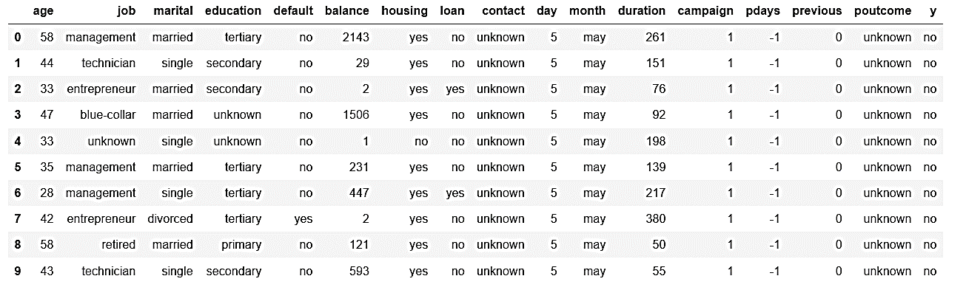
B. DATA UNDERSTANDING

Slide 14
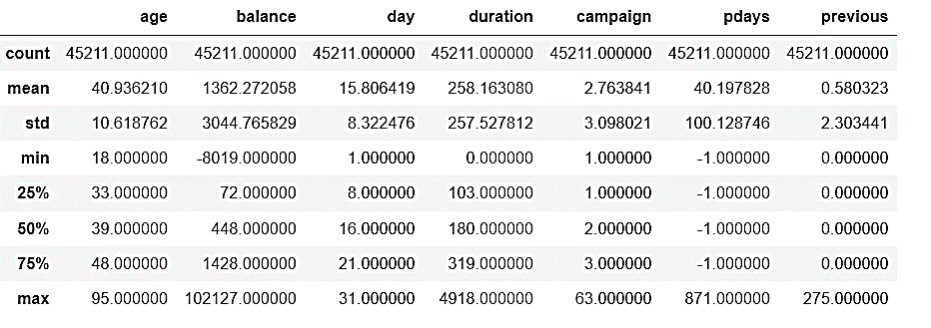
B. DATA UNDERSTANDING
SHAPE OF THE DATASET: (45211,17).
THERE ARE 7 NUMERIC VARIABLES AND THE REST ARE CATEGORICAL IN WHICH SOME ARE BINARY AND SOME HAVE MORE THATN TOW CATEGORIES

Slide 15
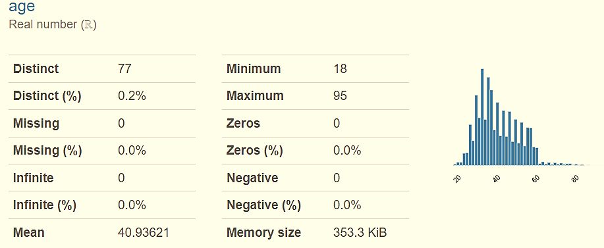
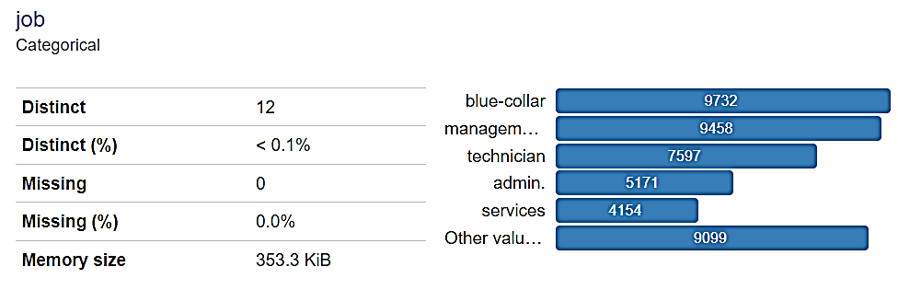
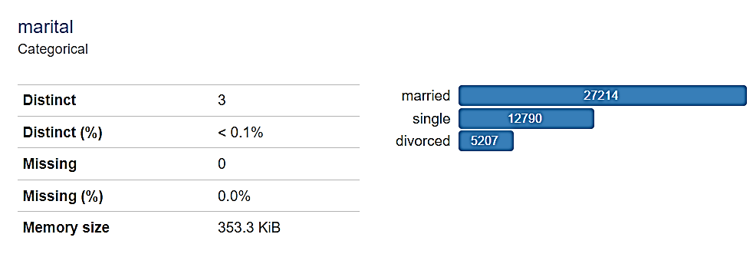
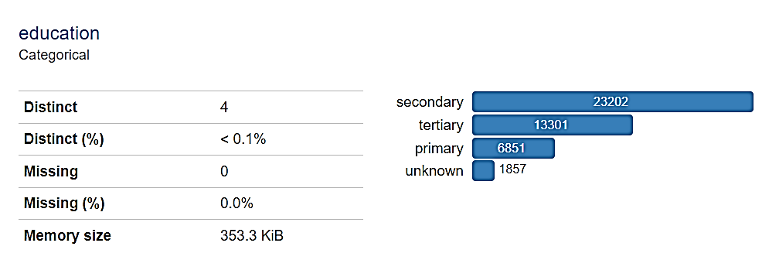

Slide 16
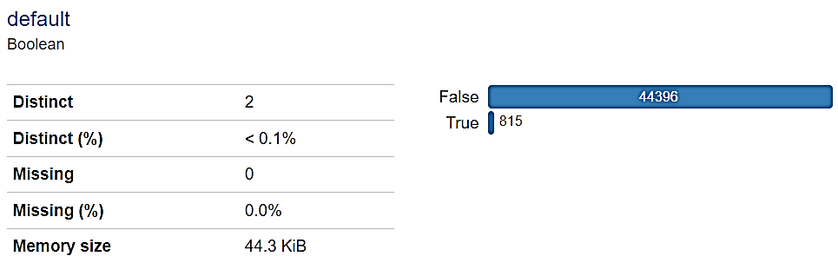
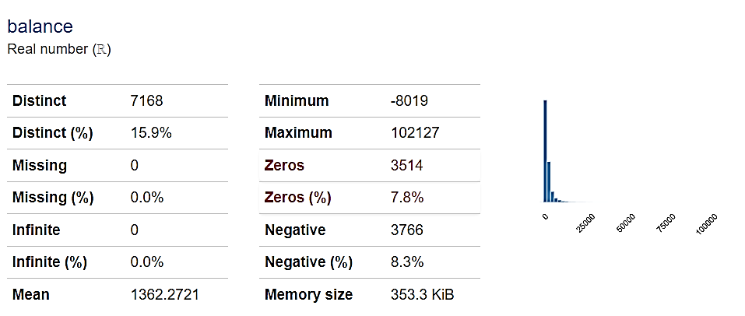
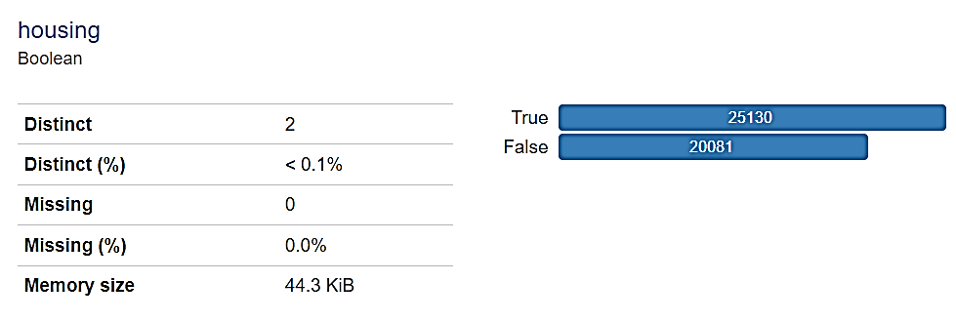
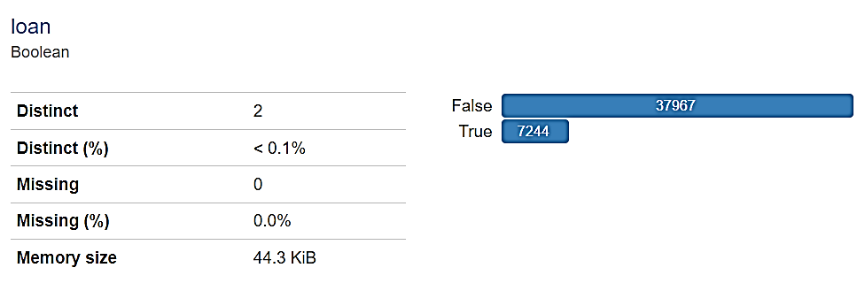

Slide 17
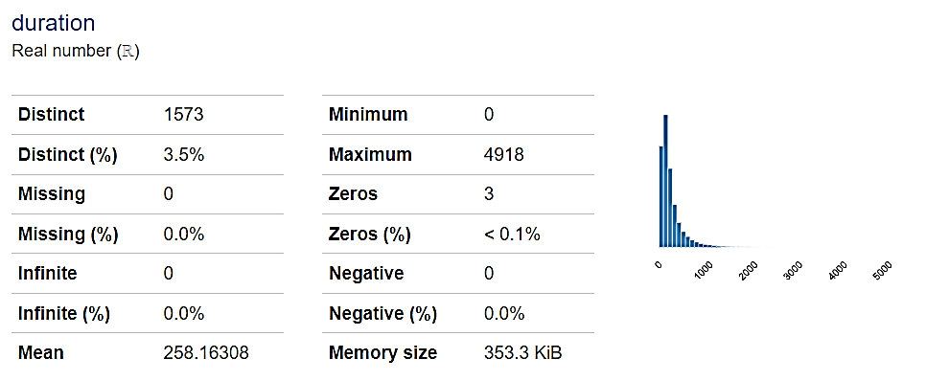
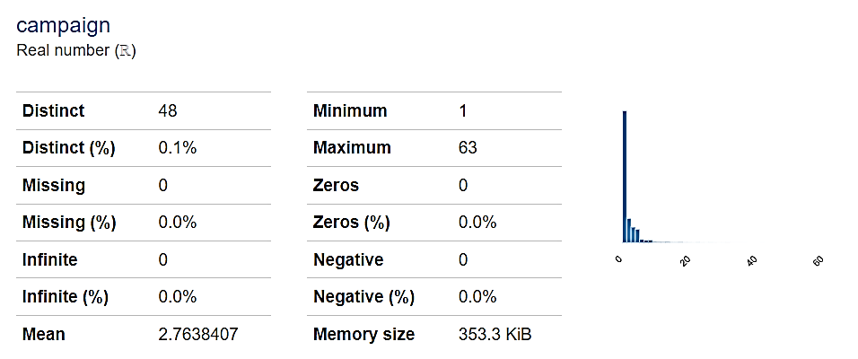
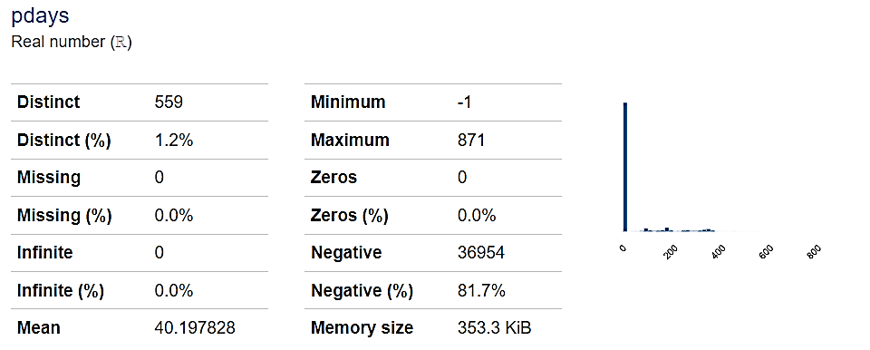
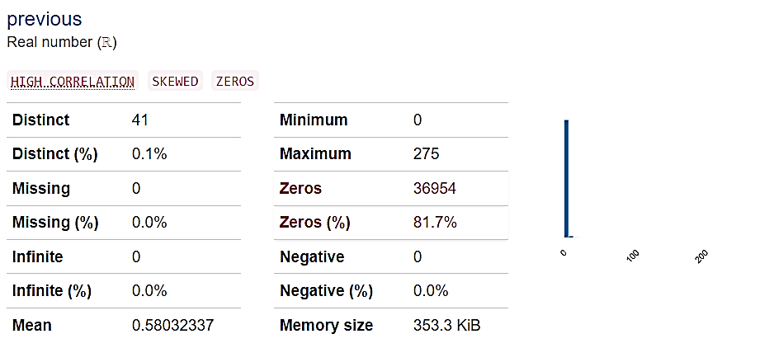

Slide 18
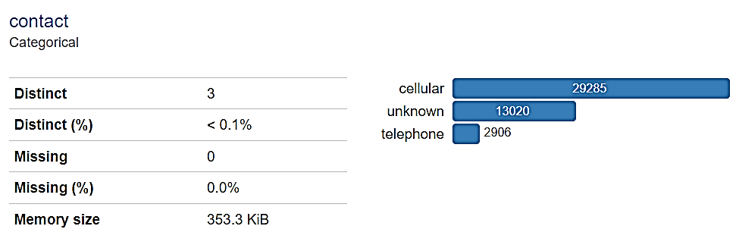
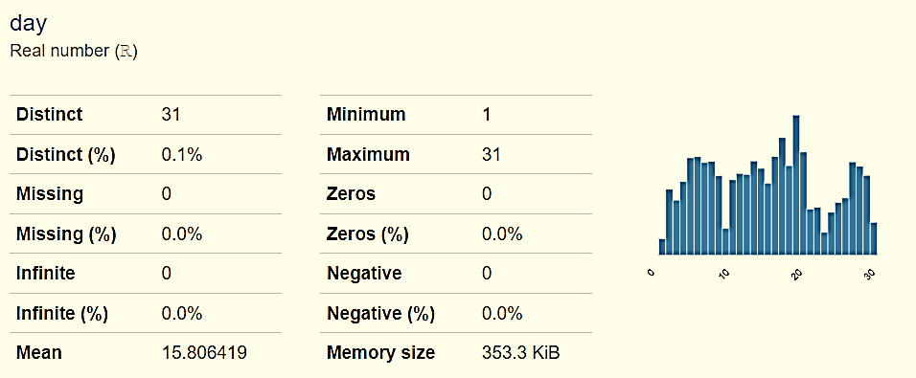
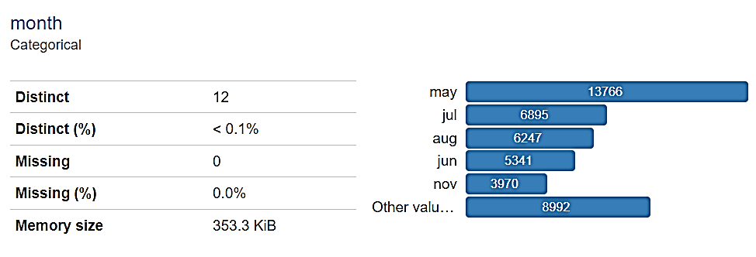
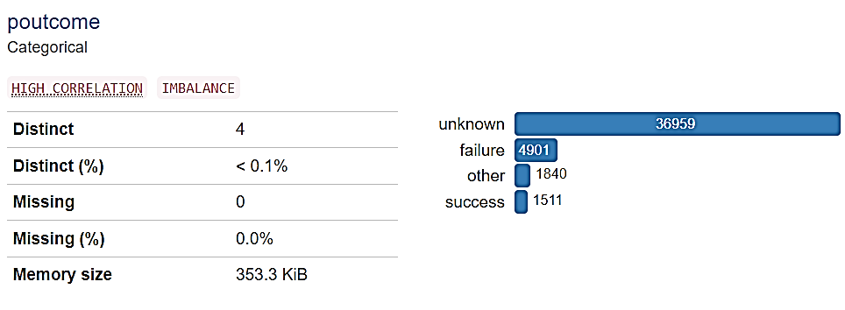

Slide 19
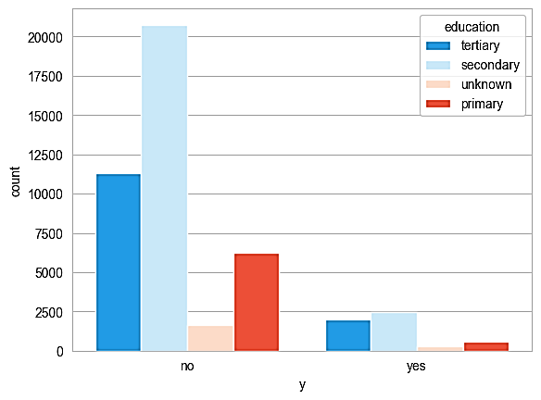
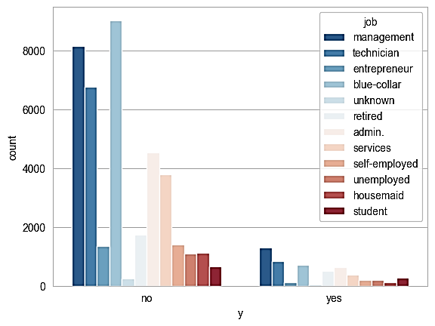
B. DATA UNDERSTANDING
DATA SET IS HIGHLY IMBALANCED: 88.30% OF ‘YES’ AND 11.70% OF ‘NO’ CLASS

Slide 20
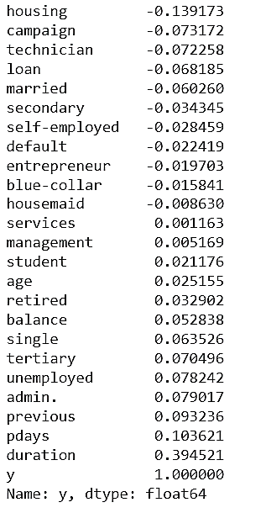
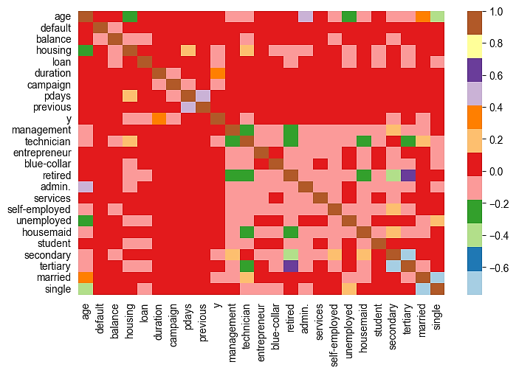
B. DATA UNDERSTANDING (CORRELATION)

Slide 21
C. DATA PRE- PROCESSING
DROPPED THE IRRELAVENT COLUMNS : 'DAY' & 'MONTH' COLUMNS AS 'PDAYS' GIVES THE NUMBER OF DAYS THAT PASSED BY AFTER THE CLIENT WAS LAST CONTACTED FROM A PREVIOUS CAMPAIGN.
‘POUTCOME’ AND ‘CONTACT COLUMNS ALSO DROPPED, BECAUSE BOTH HAVE MANY NULL/UNKNOWN VALUES.
OTHER CATEGORICAL VARIABLES ENCODED AND CONVERTED TO DUMMY VARIABLES BY USING APPROPRIATE ENCODING TECHNIQUES.

Slide 22
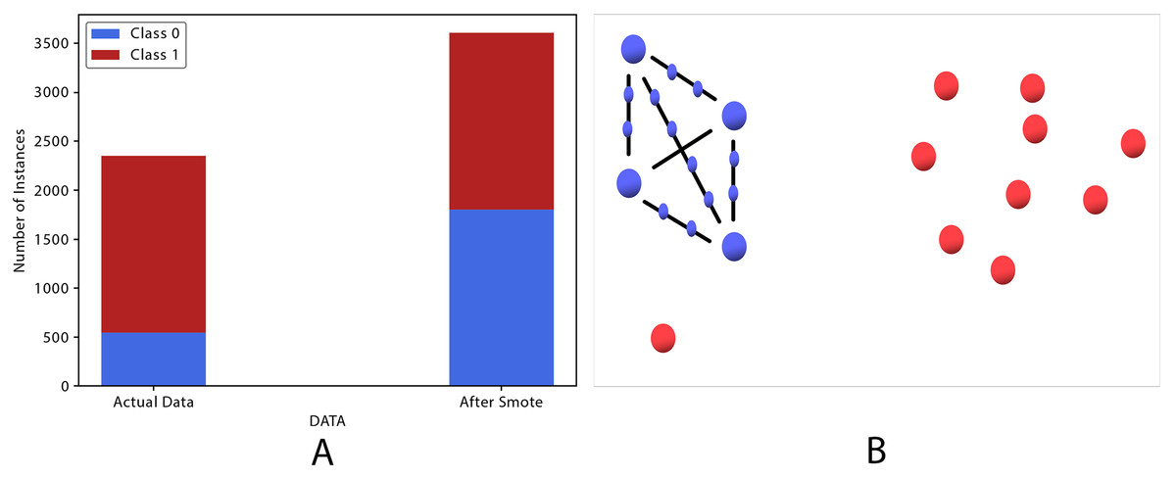
C. DATA PRE-PROCESSING
UPSAMPLING TECHNIQUE IS USED TO BALANCED THE DATASET.
SMOTE: SMOTE (SYNTHETIC MINORITY OVERSAMPLING TECHNIQUE) IS A MORE SOPHISTICATED OVERSAMPLING METHOD THAT CREATES SYNTHETIC INSTANCES OF THE MINORITY CLASS BY INTERPOLATING BETWEEN EXISTING INSTANCES.
This Photo by Unknown Author is licensed under CC BY

Slide 23
D. MODEL BUILDING
LOGISTIC REGRESSION: LOGISTIC REGRESSION (ALSO CALLED LOGIT REGRESSION) IS COMMONLY USED TO ESTIMATE THE PROBABILITY THAT AN INSTANCE BELONGS TO A PARTICULAR CLASS (E.G., WHAT IS THE PROBABILITY THAT THIS EMAIL IS SPAM?). IF THE ESTIMATED PROBABILITY IS GREATER THAN 50%, THEN THE MODEL PREDICTS THAT THE INSTANCE BELONGS TO THAT CLASS (CALLED THE POSITIVE CLASS, LABELLED “1”), OR ELSE IT PREDICTS THAT IT DOES NOT (I.E. IT BELONGS TO THE NEGATIVE CLASS, LABELLED “0”). IN LOGISTIC REGRESSION, WE USE THE LOGISTIC FUNCTION: $p\left(x\right)=\frac{ⅇ^{β_{0}+β_{1}x}}{1+ⅇ^{β_{0}+β_{1}x}}$
LOGISTIC REGRESSION: LOGISTIC REGRESSION (ALSO CALLED LOGIT REGRESSION) IS COMMONLY USED TO ESTIMATE THE PROBABILITY THAT AN INSTANCE BELONGS TO A PARTICULAR CLASS (E.G., WHAT IS THE PROBABILITY THAT THIS EMAIL IS SPAM?). IF THE ESTIMATED PROBABILITY IS GREATER THAN 50%, THEN THE MODEL PREDICTS THAT THE INSTANCE BELONGS TO THAT CLASS (CALLED THE POSITIVE CLASS, LABELLED “1”), OR ELSE IT PREDICTS THAT IT DOES NOT (I.E. IT BELONGS TO THE NEGATIVE CLASS, LABELLED “0”). IN LOGISTIC REGRESSION, WE USE THE LOGISTIC FUNCTION: 𝑝(𝑥)=ⅇ^(𝛽_0+𝛽_1 𝑥)/(1+ⅇ^(𝛽_0+𝛽_1 𝑥) )
DECISION TREE: A DECISION TREE CLASSIFIER IS A SUPERVISED LEARNING ALGORITHM THAT USES A TREE-LIKE STRUCTURE TO MAKE PREDICTIONS. THE TREE IS CONSTRUCTED BY RECURSIVELY SPLITTING THE DATA INTO SMALLER AND SMALLER SUBSETS UNTIL EACH SUBSET IS PURE. A PURE SUBSET IS A SUBSET IN WHICH ALL OF THE DATA POINTS BELONG TO THE SAME CLASS.
RANDOM FOREST: A RANDOM FOREST CLASSIFIER IS A SUPERVISED LEARNING ALGORITHM THAT USES DECISION TREES TO MAKE PREDICTIONS. IT IS A META-ESTIMATOR, MEANING THAT IT CREATES A MODEL BY COMBINING MULTIPLE DECISION TREES. THE RANDOM FOREST ALGORITHM IS KNOWN FOR ITS HIGH ACCURACY AND ITS ABILITY TO HANDLE LARGE DATASETS WITH MANY FEATURES.
XG-BOOST: XGBOOST, OR EXTREME GRADIENT BOOSTING, IS A POPULAR MACHINE LEARNING ALGORITHM FOR CLASSIFICATION AND REGRESSION TASKS. IT IS BASED ON THE GRADIENT BOOSTING ALGORITHM, BUT IT HAS BEEN EXTENDED TO HANDLE A WIDER RANGE OF PROBLEMS. XGBOOST WORKS BY ITERATIVELY ADDING NEW TREES TO A MODEL. EACH TREE IS TRAINED TO CORRECT THE ERRORS MADE BY THE PREVIOUS TREES. THIS PROCESS IS REPEATED UNTIL THE MODEL CONVERGES OR REACHES A SPECIFIED NUMBER OF ITERATIONS.
LOGISTIC REGRESSION EXAMPLE

Slide 24
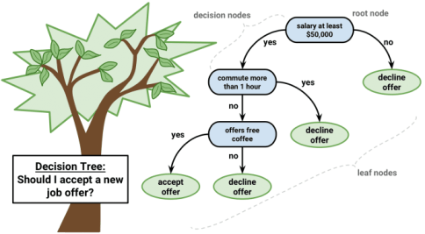
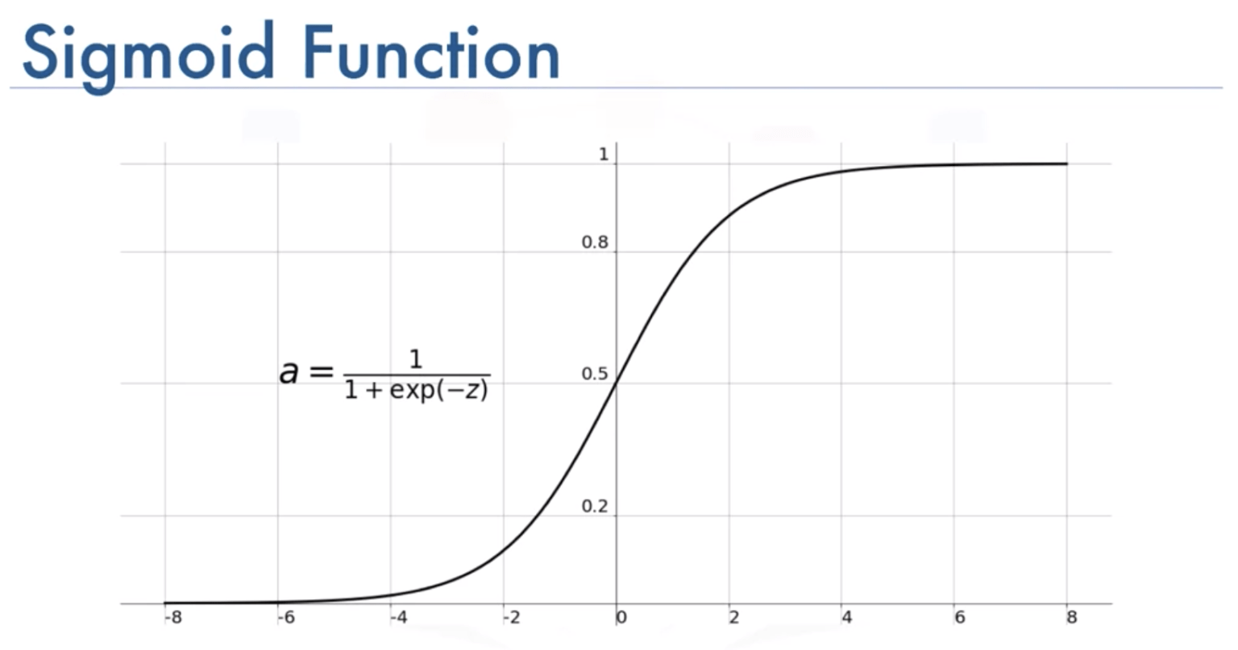

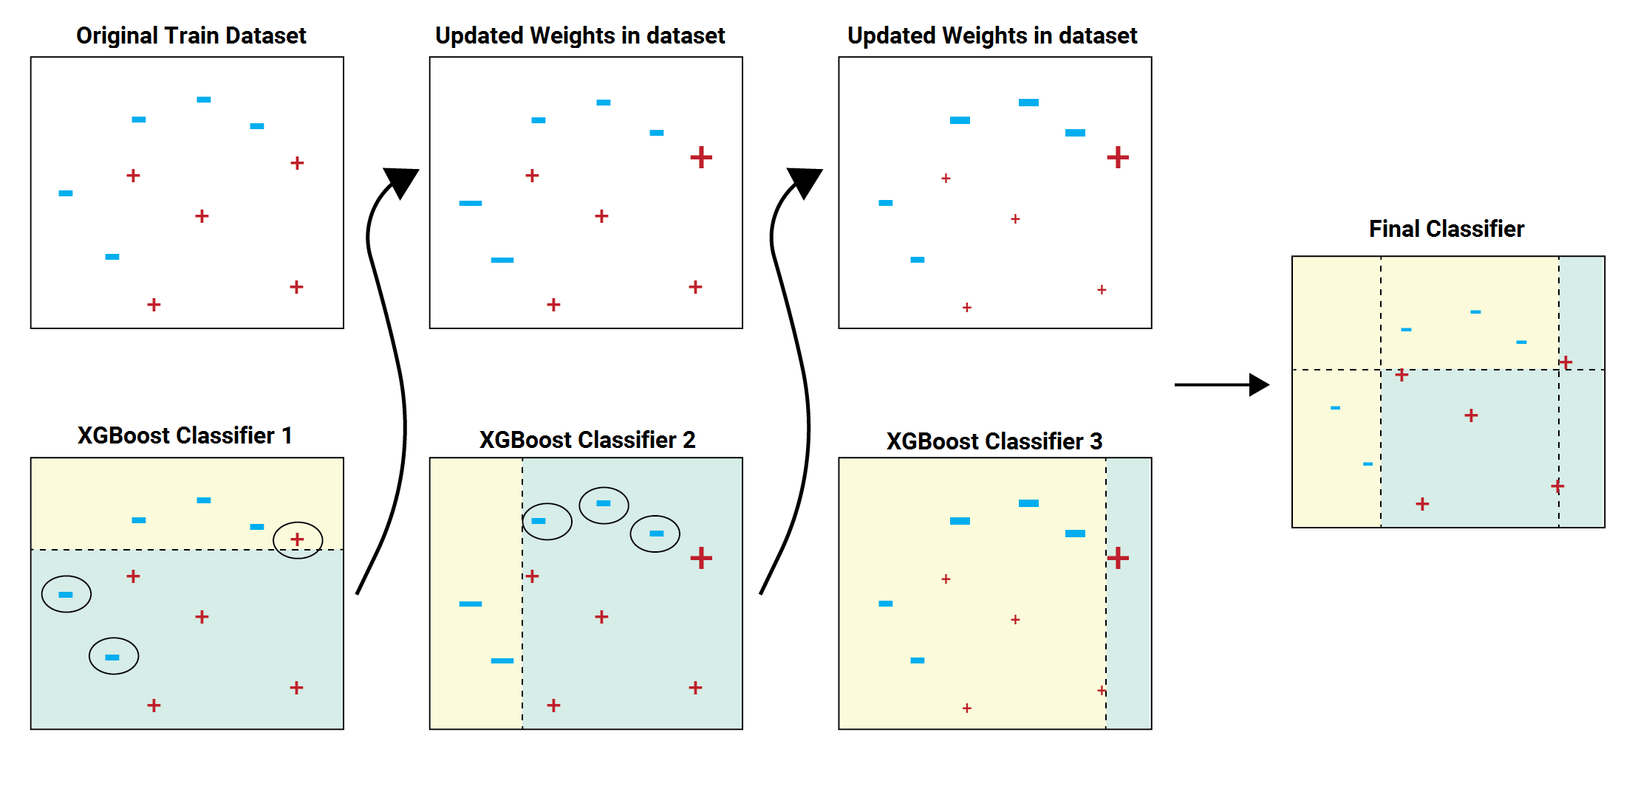
D. MODEL BUILDING
EXAMPLE OF RANDOM FOREST CLASSIFIER
This Photo by Unknown Author is licensed under CC BY

Slide 25
D. MODEL BUILDING: CROSS VALIDATION
CROSS-VALIDATION IS A TECHNIQUE FOR VALIDATING THE MODEL EFFICIENCY BY TRAINING IT ON THE SUBSET OF INPUT DATA AND TESTING ON A PREVIOUSLY UNSEEN SUBSET OF THE INPUT DATA. WE CAN ALSO SAY THAT IT IS A TECHNIQUE TO CHECK HOW A STATISTICAL MODEL GENERALIZES TO AN INDEPENDENT DATASET.
THE BASIC STEPS OF CROSS-VALIDATIONS ARE:
RESERVE A SUBSET OF THE DATASET AS A VALIDATION SET.
PROVIDE THE TRAINING TO THE MODEL USING THE TRAINING DATASET.
NOW, EVALUATE MODEL PERFORMANCE USING THE VALIDATION SET. IF THE MODEL PERFORMS WELL WITH THE VALIDATION SET, PERFORM THE FURTHER STEP, ELSE CHECK FOR THE ISSUES.

Slide 26
E. MODEL EVALUATION
THIS STEP CONSISTS OF: DEFINING ACCURACY MEASURES, PARAMETER TUNING, ACCURACY ASSESSMENT OF DIFFERENT CLASSIFIERS, AND COMPARING THE PERFORMANCE OF DIFFERENT CLASSIFIERS.
ACCRACY MEASURES FOR CLASSIFICATION MODELS CAN BE MANY SUCH AS:
ACCURACY’ $Accuracy=\frac{Number of correctly classified instances}{Total instances}$
ACCURACY’ 𝐴𝑐𝑐𝑢𝑟𝑎𝑐𝑦=(𝑁𝑢𝑚𝑏𝑒𝑟 𝑜𝑓 𝑐𝑜𝑟𝑟𝑒𝑐𝑡𝑙𝑦 𝑐𝑙𝑎𝑠𝑠𝑖𝑓𝑖𝑒𝑑 𝑖𝑛𝑠𝑡𝑎𝑛𝑐𝑒𝑠)/(𝑇𝑜𝑡𝑎𝑙 𝑖𝑛𝑠𝑡𝑎𝑛𝑐𝑒𝑠)
PRECISION $Precision=\frac{TP}{TP+FP}$
PRECISION 𝑃𝑟𝑒𝑐𝑖𝑠𝑖𝑜𝑛=𝑇𝑃/(𝑇𝑃+𝐹𝑃)
RECALL $Recall=\frac{TP}{TP+FN}$
RECALL 𝑅𝑒𝑐𝑎𝑙𝑙=𝑇𝑃/(𝑇𝑃+𝐹𝑁)
F1- SCORE $F1−score=\frac{2∗precision∗recall}{precision+recall}$
F1- SCORE 𝐹1−𝑠𝑐𝑜𝑟𝑒=(2∗𝑝𝑟𝑒𝑐𝑖𝑠𝑖𝑜𝑛∗𝑟𝑒𝑐𝑎𝑙𝑙)/(𝑝𝑟𝑒𝑐𝑖𝑠𝑖𝑜𝑛+𝑟𝑒𝑐𝑎𝑙𝑙)
AUC- ROC CURVES

Slide 27
5. RESULTS AND DISCUSSION
THE DATASET WAS HIGHLY IMBALANCED BECAUSE WHEN I CHECKED, THERE WERE 88.30% OF THE ‘NO’ CLASS AND 11.70% OF THE ‘YES’ CLASS FIELDS.
SO, I USED AN OVER-SAMPLING TECHNIQUE TO GENERATE THE SYNTHETIC DATA AND BALANCED THE DATASET. I ALSO CHECKED THE ACCURACY OF CLASSIFIERS ON BOTH THE BALANCED AND THE UNBALANCED DATASETS AS WELL AS SCALED AND NON-SCALED DATASETS.

Slide 28
5. RESULTS AND DISCUSSION
I NOTICED THAT WHEN I APPLIED THE CLASSIFICATION ALGORITHMS ON THE BALANCED AS WELL AS ON THE IMBALANCED DATASETS, THEY GIVE MORE ACCURACY ON THE BALANCED DATASET THAN THE IMBALANCED DATASET.
FOR INSTANCE, WHEN I FIT THE DECISION TREE MODEL ON THE IMBALANCED DATASET, IT GIVES 89.29% ACCURACY. ON THE OTHER HAND, WHEN I FIT THE DECISION TREE MODEL ON THE BALANCED DATASET, IT GIVES APPROX. 90.82% ACCURACY.
SIMILARLY, IN THE CASE OF THE RANDOM FOREST CLASSIFIER, THE MODEL GIVES APPROX. 88.30% ACCURACY ON THE IMBALANCED DATASET, AND GIVES APPROX. 93.53% ACCURACY ON THE BALANCED DATASET.
AS WE KNOW THAT THE ACCURACY MATRIX PRECISION, RECALL, AND F1-SCORE PROVIDE GOOD RESULTS ON THE BALANCED DATASET, THIS ALSO REFLECTS IN MY RESULTS WHICH IS GIVEN IN THE BELOW TABLE.
SO, I DECIDED TO WORK WITH A BALANCED DATASET AND COMPARE THE RESULTS OF SCALED AND NON-SCALED DATASETS.

Slide 29
5. RESULTS AND DISCUSSION
Models | Resampled (Yes/No) | Accuracy % | Precision |  | Recall |  | F1-Score
 |  |  | ‘0’ class | ‘1’ class | ‘0’ class | ‘1’ class | ‘0’ class | ‘1’ class
Decision Tree | No | 89.29 | 0.92 | 0.59 | 0.96 | 0.39 | 0.94 | 0.47
 | Yes | 90.82 | 0.92 | 0.90 | 0.87 | 0.94 | 0.89 | 0.92
Random Forest | No | 88.30 | 0.89 | 0.63 | 1.0 | 0.3 | 0.94 | 0.6
 | Yes | 90.53 | 0.94 | 0.93 | 0.91 | 0.95 | 0.92 | 0.94
Table : Results of classifiers on balanced and imbalanced datasets

Slide 30
WHEN I USED, THE DECISION TREE CLASSIFIER ON THE NON-SCALED DATASET, IT GIVES 90.61% ACCURACY. ON THE OTHER HAND, THE DECISION TREE CLASSIFIER GIVES 90.71% ACCURACY ON THE SCALED DATASET.
THE RANDOM FOREST CLASSIFIER GIVES 93.23% ACCURACY ON THE NON-SCALED DATASET AND 93.26% ACCURACY ON THE SCALED DATASET.
THE LOGISTIC REGRESSION MODEL GIVES 90.71% ACCURACY ON THE NON-SCALED DATASET AND 89.93% ACCURACY ON THE SCALED DATASET.
XG-BOOST CLASSIFIER GIVES 96.53% ACCURACY ON THE NON-SCALED DATASET AND 96.42% ACCURACY ON THE SCALED DATASET.
AFTER FINDING THIS I ALSO TRIED PCA, BUT IT REDUCED THE ACCURACY VERY MUCH (63% ACCURACY) OF THE CLASSIFIERS. THEREFORE, IT WILL NOT BE A GOOD TRADE-OFF.
SO, I HAVE USED THE DATASET WITHOUT APPLYING THE PCA. BELOW IS THE TABLE OF RESULTS AND AUC-ROC CURVES, AND I HAVE USED AVERAGE SCORE ACCURACY MATRICES OF BOTH THE CLASSES.

Slide 31
5. RESULTS AND DISCUSSION

Slide 32
5. RESULTS AND DISCUSSIONS
SINCE XG-BOOST CLASSIFIER IS PROVIDING THE BEST ACCURACY, I HAVE USED THE RANDOM SEARCH METHOD TO TUNE THE HYPERPARAMETERS IN THIS MODEL AND GOT THE BEST HYPERPARAMETERS: {'COLSAMPLE_BYTREE': 0.8496231729751094, 'GAMMA': 0.09983689107917987, 'LEARNING_RATE': 0.1642703315240835, 'MAX_DEPTH': 9, 'N_ESTIMATORS': 180, 'REG_LAMBDA': 1.719880813472641, 'SUBSAMPLE': 0.7762152770114458}. WHEN I USED THESE PARAMETERS, THEY INCREASED THE ACCURACY OF THE MODEL A LITTLE BIT.
AFTER TUNING THE PARAMETERS, I HAVE GOT THE RESULTS:

Slide 33
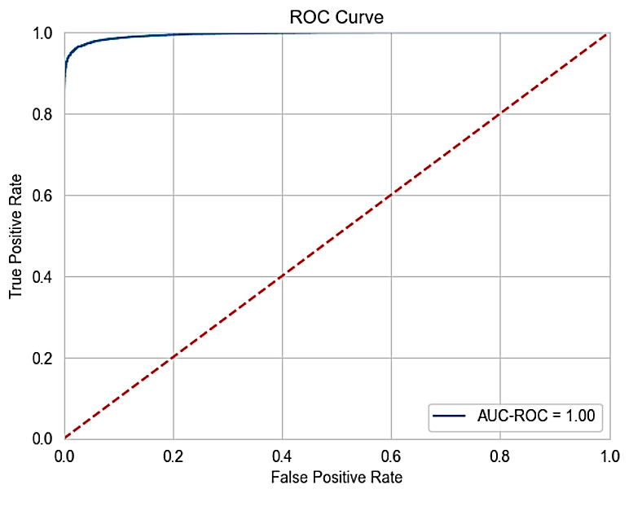
RESULTS AND DISCUSSION:
ROC- AUC CURVE OF THE FINAL MODEL:
THAT INDICATES THAT MODEL IS GOOD.

Slide 34
6. CONCLUSIONS
I FOUND THAT USING SCALED OR NON-SCALED DATASETS HAD NO APPRECIABLE IMPACT ON THE OUTCOMES USING THE PROPOSED SYSTEM AND SEVERAL CLASSIFICATION ALGORITHMS ON THE PORTUGUESE BANKING DATASET.
WHEN WORKING WITH UNBALANCED DATASETS, I ALSO DISCOVERED THAT OVERSAMPLING STRATEGIES MAY YIELD EXCELLENT RESULTS.
IN THE END, I FIND THAT THE XG-BOOST CLASSIFIER PERFORMS THE BEST ON THE DATASET, WITH AN ACCURACY OF ABOUT 96.7 PERCENT AFTER FURTHER TUNING THE MODEL.

Slide 35
THANK YOU

